Slide 1
Hotel Jashree
Hotel Management
Hotel Web Application
Copyright © webieon technologies Pvt.Ltd

Slide 2
Hotel Jashree
Hotel Management
About Us
Webieon Technologies Pvt. Ltd, a diversified technology company, is committed to providing the highest quality services and outsourced software product and applications development services to the global IT industry. We understand that, as a business owner, you need solutions that are proven to work and investing in exceptional people and ideas both our own, and that of our customers
Vision
To be the leading provider of high end, best of breed product engineering life cycle solutions to the global software development and IT industry.
Mission Statement
To achieve our objective in an environment that fosters honesty, fairness and integrity and a single minded focus on the success of our customers.
Copyright © webieon technologies Pvt.Ltd

Slide 3
Hotel Jashree
Hotel Management
Introduction:
Hotel application is a online web based application which covers all the aspects of hotel management. This application covers the following features
Online Booking
Online payment
Services Provided
customer Database
Billing
Employee Database
Stock Management
History of Hotel/Press Releases/Events/Contact Details
SMS & Email Services
Back office
Copyright © webieon technologies Pvt.Ltd

Slide 4
Hotel Jashree
Hotel Management
Product Features:
Online Booking
Customer can check the availability of rooms online as per dates/calendar.
Customer can check online tariff and special offers.
Copyright © webieon technologies Pvt.Ltd

Slide 5
Hotel Jashree
Hotel Management
Product Features:
Online Payment
Customer can make online payments and book the rooms.
Copyright © webieon technologies Pvt.Ltd

Slide 6
Hotel Jashree
Hotel Management
Product Features:
Services Provided: Hotel can list the different type of services available
Different Standard of rooms
Dining/Restaurant
24 X 7 Hour Business Center
Swimming Pool
Doctor on call
Laundry
Car Rental / Travel Desk
Currency Exchange
Rooms Butler and Valet Service ,etc.,
Copyright © webieon technologies Pvt.Ltd

Slide 7
Hotel Jashree
Hotel Management
Product Features:
customer Database :
Customer Image
Personal Information
Booking Details
Copyright © webieon technologies Pvt.Ltd

Slide 8
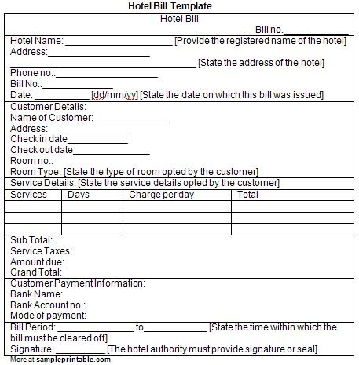
Hotel Jashree
Hotel Management
Product Features:
Billing :
Advance Receipt
We can generate check In, Check Out Receipt
Dining / Restaurant / Laundry /Other items.
Copyright © webieon technologies Pvt.Ltd

Slide 9
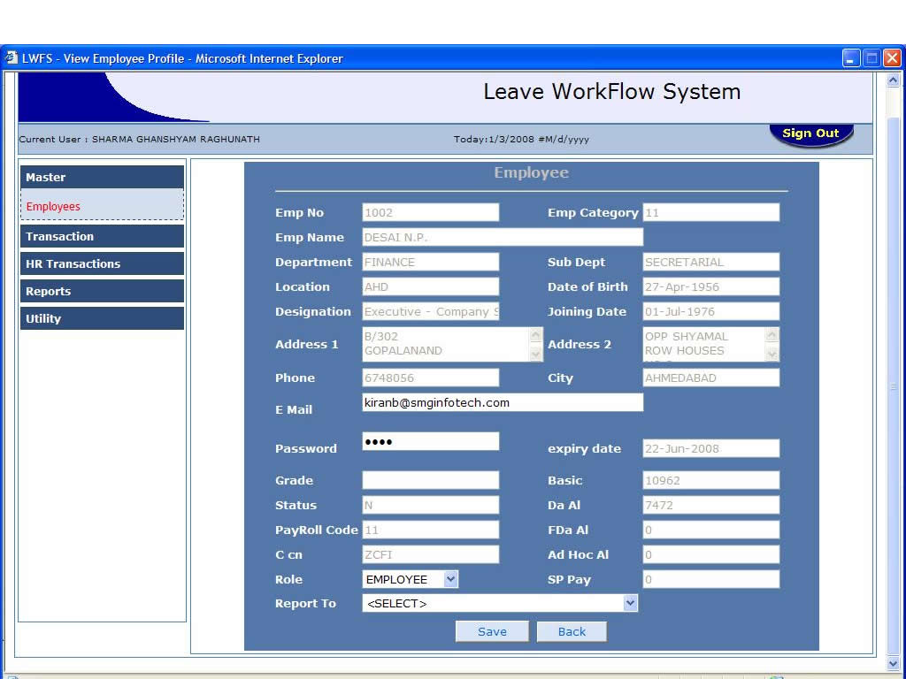
Hotel Jashree
Hotel Management
Product Features:
Employee Database:
Employee personal/professional Information
Employee attendance
Copyright © webieon technologies Pvt.Ltd

Slide 10
Hotel Jashree
Hotel Management
Product Features:
Stock Management :
Hotel Assets Details
Hotel In & Out Material Management
Copyright © webieon technologies Pvt.Ltd

Slide 11
Hotel Jashree
Hotel Management
Product Features:
SMS & Email Services:
Sending Booking Status through SMS & Email
send the Different Offer available for existing customers
Copyright © webieon technologies Pvt.Ltd

Slide 12
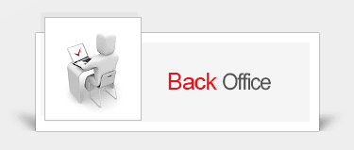
Hotel Jashree
Hotel Management
Product Features:
Back Office: Backend user with administrative rights
User can update information on website
Update Employee & Customer database
Announcements, Press releases
Copyright © webieon technologies Pvt.Ltd

Slide 13
Hotel Jashree
Hotel Management
User Classes and Characteristics:
The admin, will be the main user. The system is also designed to be user-friendly.
Admin
Operators
Admin:
Admin should have prior knowledge of the system. Admin is able to control the whole system. He/she can add, delete, update and modify the system.
Operators :
Operator should fairly know about the usage of the system.
Casual users :
Anyone can view the information of the Hotel.
Copyright © webieon technologies Pvt.Ltd

Slide 14
Hotel Jashree
Hotel Management
Screen Shots
of
HOTEL:
Copyright © webieon technologies Pvt.Ltd

Slide 15
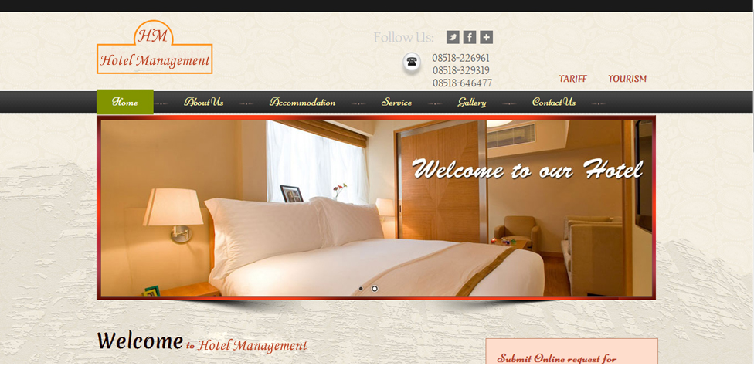
Hotel Jashree
Hotel Management
SYSTEM DESIGN:
Screen Shots:
Front end of the hotel application.
Copyright © webieon technologies Pvt.Ltd

Slide 16
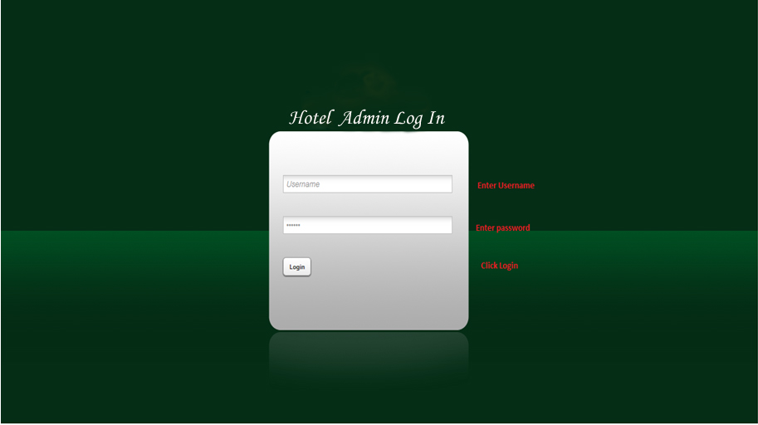
Hotel Jashree
Hotel Management
SYSTEM DESIGN:
Screen Shots:
Admin Login: There will be an unique id and password for admin login.
Copyright © webieon technologies Pvt.Ltd

Slide 17
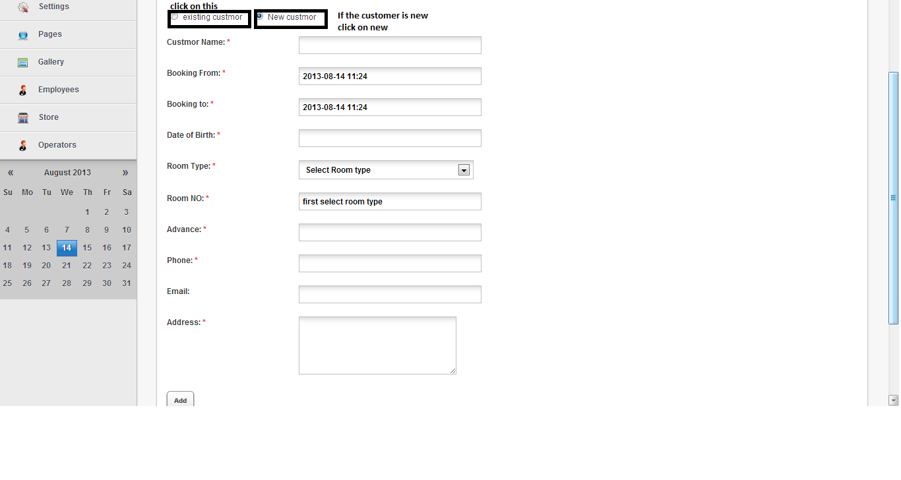
Hotel Jashree
Hotel Management
SYSTEM DESIGN:
Screen Shots:
Advance Booking:
Advance Booking of a customer. If the customer is new click on new customer otherwise click on existing customer.
Copyright © webieon technologies Pvt.Ltd

Slide 18
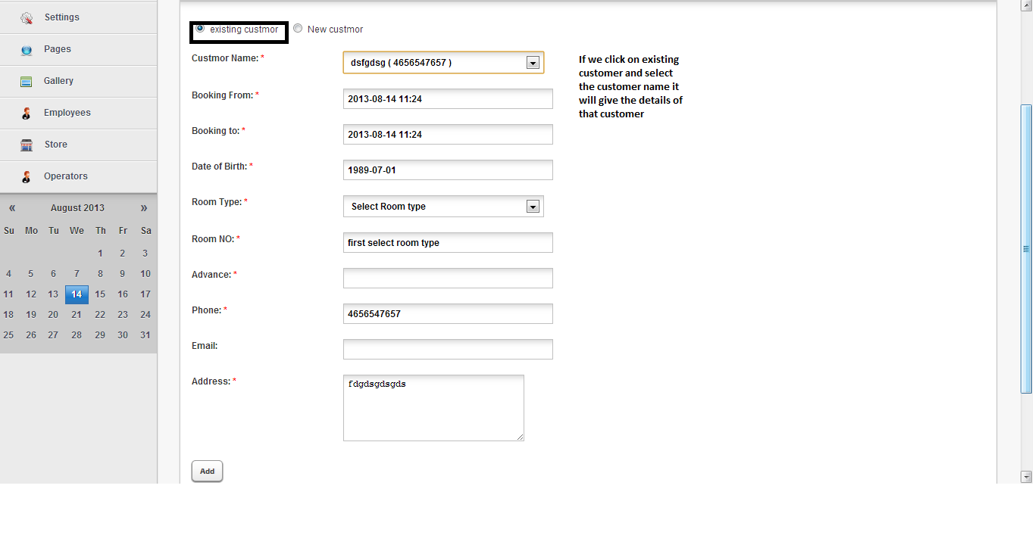
Hotel Jashree
Hotel Management
SYSTEM DESIGN:
Screen Shots:
If we click on existing customer and select name it will display the customer details.
Copyright © webieon technologies Pvt.Ltd

Slide 19
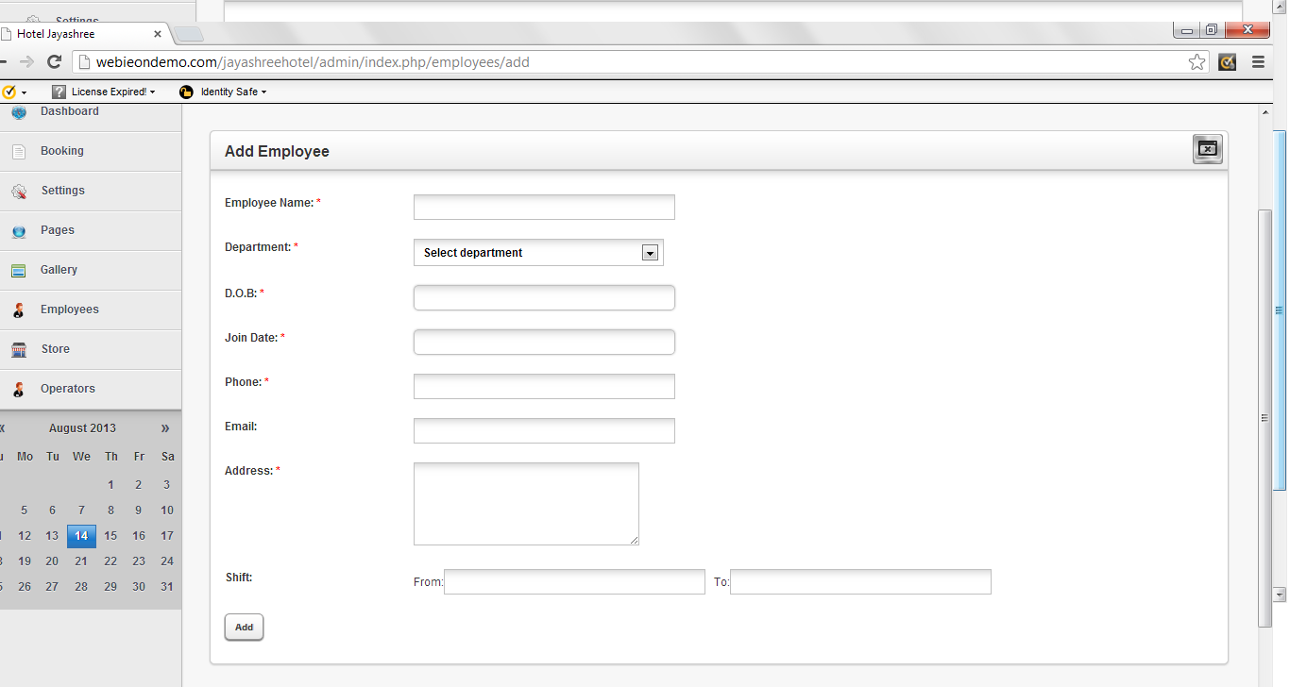
Hotel Jashree
Hotel Management
SYSTEM DESIGN:
Screen Shots:
Adding Employee :
Adding Employee details of that hotel.
Copyright © webieon technologies Pvt.Ltd

Slide 20
Hotel Jashree
Hotel Management
THANK YOU
Copyright © webieon technologies Pvt.Ltd

