Slide 1









School Management Application
Copyright © webieon technologies Pvt.Ltd

Slide 2
About Us
Webieon Technologies Pvt. Ltd, a diversified technology company, is committed to providing the highest quality services and outsourced software product and applications development services to the global IT industry. We understand that, as a business owner, you need solutions that are proven to work and investing in exceptional people and ideas both our own, and that of our customers
Vision
To be the leading provider of high end, best of breed product engineering life cycle solutions to the global software development and IT industry.
Mission Statement
To achieve our objective in an environment that fosters honesty, fairness and integrity and a single minded focus on the success of our customers.
Copyright © webieon technologies Pvt.Ltd

Slide 3
Introduction:
This Application describes School Management System,
which automates administrates tasks of management for smooth
running their day today activities and provides accurate information
as required.
This application covers the following features
  Admin / Principal
Staff
Student
Attendance
Class
Academic
Subjects
Exams
Questions
Notice Board
Bulk Upload
SMS
Feed Back
Finance
Fees
Assets or inventory
Copyright © webieon technologies Pvt.Ltd

Slide 4
ADMIN / PRINCIPAL
This Login is be maintained by school admin/Principal who has all privilege of data access. Create, modify and delete of data can be done only by using admin/principal login.
Creating class names, subjects, students, staff, exam schedule etc…
Admin/Principal has rights to assign Class Teacher to the respective class.
Overall organization reports can view by admin/Principal like student attendance, student marks, by using search criteria like by class vice, fee details, details etc.
Admin/Principal can view the feedback message sended by teacher/parent/student.
Copyright © webieon technologies Pvt.Ltd

Slide 5
ADMIN / PRINCIPAL
Admin/Principal can add/edit/delete the tutorials.
Admin/Principal has rights to promote the students from one class to another class
Admin/Principal Can Add the Question papers, Edit & Generate.
An SMS will be sent to the parents when the results are announced.
Copyright © webieon technologies Pvt.Ltd

Slide 6
STAFF
    Class Teacher :
In School there will be different types of staff like Principal/ Headmaster, Class Teacher, Teaching staff and Non-Teaching staff.
If the teaching staff is class teacher then he/she can add the attendance and can add/edit the marks of all the subjects of their particular class.
Teaching Staff :
Teaching-Staff can view the attendance for all the classes which he/she goes.
Staff Can view the marks of all the students which he/she goes but he can’t edit all the subject marks he can only edit his/her particular subject marks.
Staff can see the Events & Holidays.
Copyright © webieon technologies Pvt.Ltd

Slide 7
STUDENT / PARENT
Student user id and password are given to their respective parents where they can see their Childers performance and attitude and remarks given by their class teacher and examination schedule.
Events and school function, sports everything related to students are updated in the web site so that every parent can update day by day virtually.
Attendance can by seen for any month.
Student/Parent can send feedback messages to teacher, admin, principal.
Student can view the tutorials added by the admin/principal/staff.
Copyright © webieon technologies Pvt.Ltd

Slide 8
Attendance:
Can add the attendance of a student and the staff. Student/parent/teacher can view the attendance.
Class:
We can add the classes, sections and set the age limit for classes.
Academic:
We can select the academic year and view the details of previous year also.
Subjects:
We can add subjects for all the classes separately, Can add syllabus, edit the syllabus.
Exams:
Can add/edit exam types, time table and marks.
Questions:
Can add the question types and generate the questions by admin.
Notice board:
Latest news of the school like(events/notices/holidays)will be added here
Copyright © webieon technologies Pvt.Ltd

Slide 9
Bulk Upload:
If the management has to add more than one children at a time they can
add by downloading sample csv file and upload it.
SMS:
If the admin/principal wants to send sms to a parent they can send the sms
by using this option.
Feed Back:
Any feedback message which has been sent from teacher, parent, student will
be displayed here.
Finance:
We can generate monthly pay-slips for staff. We can add monthly general
expenses. Fee receipt can be generated & used to add the details of the expenses spent
by school.
Ex : Electricity bill & Salaries etc..
Fees:
Students fee can be added here how much fees they had paid on which date and
how much fees they has to pay all will be added here.
Copyright © webieon technologies Pvt.Ltd

Slide 10
Assets or inventory :
In Inventory
    Store category
    Store type
    Store
    Store items
    Supplier type
    Supplier
    Purchase.
    Store category : It’s nothing but whether the store is permanent or in contract based. It’s used to add this type of details.
    Store type : It’s nothing but which type of stores are there in the school
    Ex : General store, Maintains store etc..
    Store : we can add which type of stores are present in the school whether they are permanent are consumable and to which category they belongs to.
    Ex : hostel, sports etc...
    Store items : It represents what type of items are present in the stores,quantity,price etc...
    Store items are nothing but bats,pens,books etc...
    Supplier type : Supplier types are what type of items they are suppling to the school.
Copyright © webieon technologies Pvt.Ltd

Slide 11
Assets or inventory :
    Supplier : It manages which type of items they are supplying, supplier name, contact details etc..
    Purchase : It manages which type of items they are purchasing, who are purchasing the items, and all the details.
Copyright © webieon technologies Pvt.Ltd

Slide 12
Screen Shots
of
SCHOOL:
Copyright © webieon technologies Pvt.Ltd

Slide 13
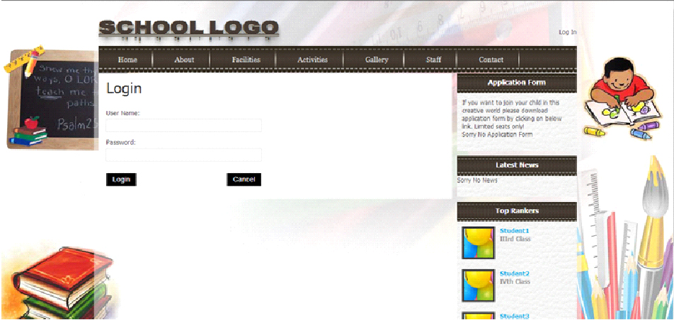
Log In
login page for
admin/student/parent/staff/principal
Copyright © webieon technologies Pvt.Ltd

Slide 14
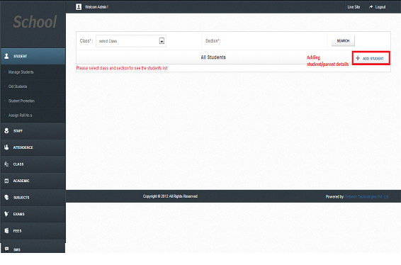
Adding Student/Parent:
Adding the details of a student/parent.
Copyright © webieon technologies Pvt.Ltd

Slide 15
Parent Login:
Parent can view the
Exam time table
Marks
Attendance
Homework,
Fees etc…
If the Parent has two children’s in a same school he can view the details of their children at a time by selecting drop down shown as in figure next page.
Copyright © webieon technologies Pvt.Ltd

Slide 16
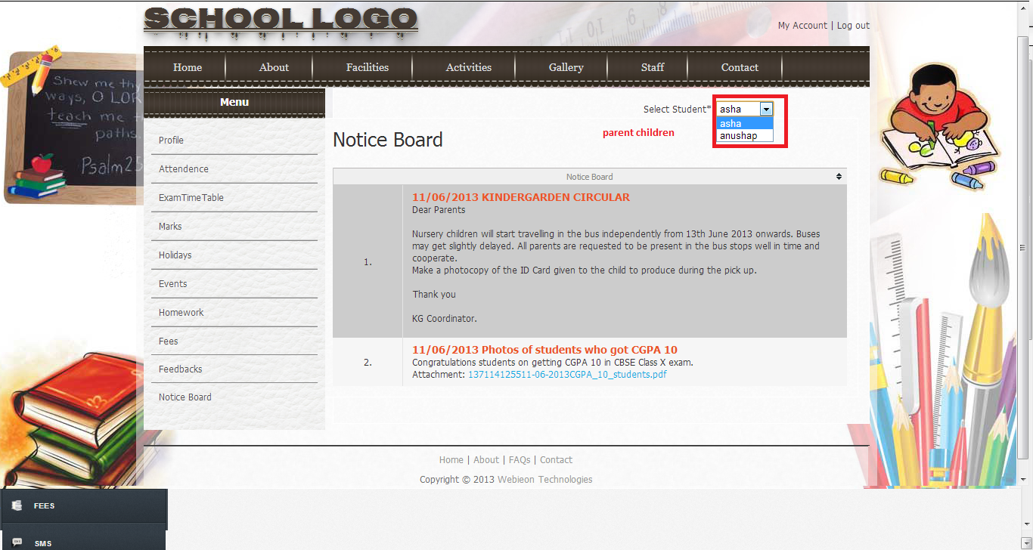
Parent Login:
Copyright © webieon technologies Pvt.Ltd

Slide 17
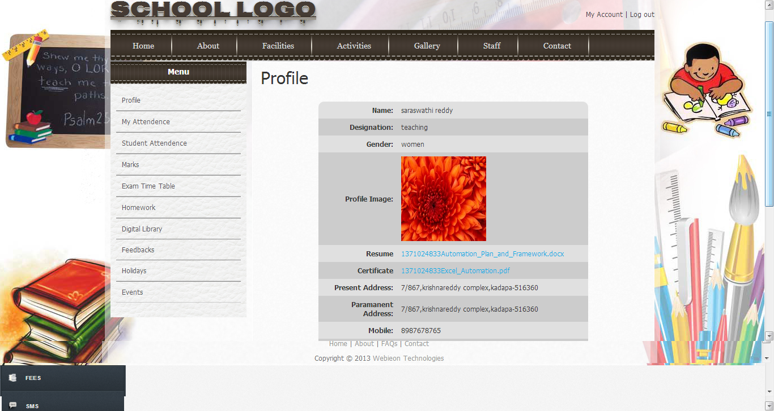
Staff Login:
Staff can add attendance, marks, homework, digital library, Feed backs etc…. Only the class teacher can add/edit marks and remaining staff can edit only their subject marks. Attendance can be only viewed by the staff, only the class teacher can keep the attendance.
Copyright © webieon technologies Pvt.Ltd

Slide 18
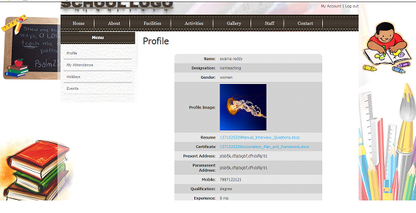
Non-Teaching Staff Login:
He can only view his profile, attendance, holidays and events. See below figure of non-teaching staff.
Copyright © webieon technologies Pvt.Ltd

Slide 19
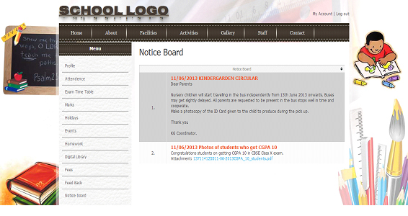
Student Login:
Student can view his/her attendance, marks, homework, tutorial, feedback and exam schedule etc….
Copyright © webieon technologies Pvt.Ltd

Slide 20
Advantages:
School :
The school can maintain a thorough database of every student in the school.
This will give an instance access to any information as soon as it is needed.
It helps regularly to keep in touch with the parents about their child's
exam results, special functions, Holidays, attendance & his overall performance.
Parent :
Every parent is given a login id so that they can view their child's result
and overall performance.
Parents will regularly get the details about Parents Meeting, Results,
Cultural function, fee, excursion & special events etc... as soon as it is announced.
The parent will get to know about their child's absence to the class.
If parents require any detailed information about there child,
they can place a request through mobile or email and will be same.
Copyright © webieon technologies Pvt.Ltd

Slide 21
Advantages:
Student:
Students can view all there results, exam schedule, homework, tutorials etc….
They can get the intimation about special events like sports, Holiday, cultural events & excursion as soon as it is announced.
Copyright © webieon technologies Pvt.Ltd

Slide 22
THANK YOU
Copyright © webieon technologies Pvt.Ltd

